Slide 1
National orange wine day
October 6, 2018

Slide 2
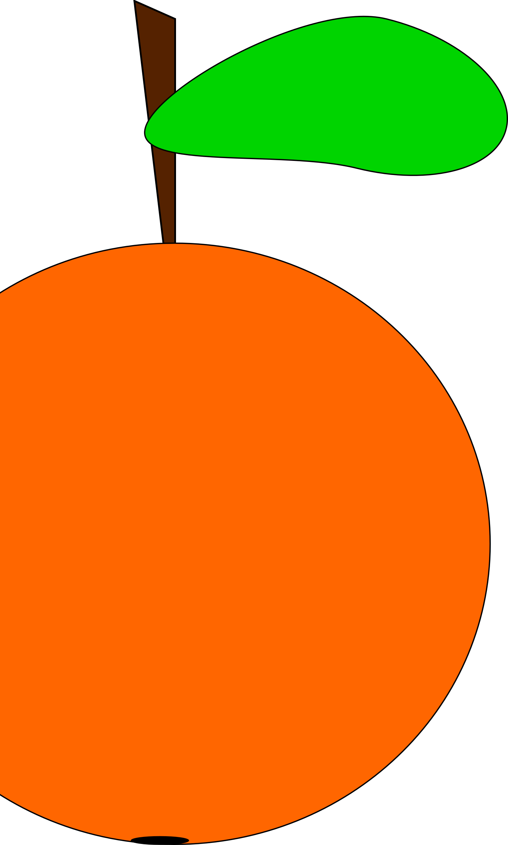
What the heck is orange wine
The average American consumer has no idea what orange wine is.
When asked many people think its wine made from oranges
National Orange Wine Day was established to bring greater awareness to the general consumer about this unique yet lesser known style of wine.
Orange wine is a wine made from white grapes that have skin contact during the fermentation process. White wine is fermented grape juice.
Orange wine is not made from Oranges

Slide 3
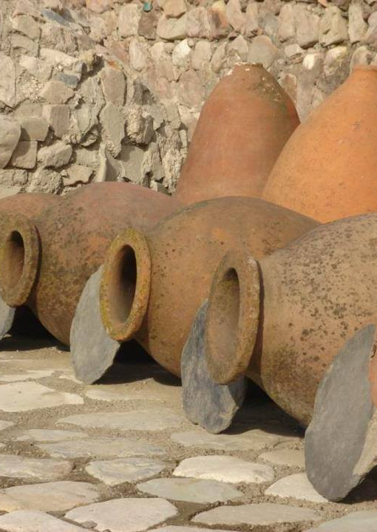
The history of orange wine
Archeological evidence suggests that the Amphora (Qveri) method commonly used in orange wine making dates as far back as 6,000 years BC in what is now the country of Georgia; also known as the cradle of wine (National Geographic, 5/2018).
The Orange Wine making process was popularized in Italy by Winemaker Josko Gravner who first attempted an orange wine in 1997 (Wine Folly, 11/2015).
David Harvey, a British wine importer from Raeburn Fine Wine coined the term “Orange Wine.”
Orange wine is also called Ramato, Amber, or Skin contact, and tends to fall into the undefined category of natural wines.
Natural wines to date has no official category designation. The generally accepted practices include:
  Grapes grown organically or biodymanically and harvested by hand
  Fermentation with native or wild yeasts
  No enzymes or additives except for up to 50ppm sulfites
  Filtration is also not commonly practiced
This Photo by Unknown Author is licensed under CC BY

Slide 4
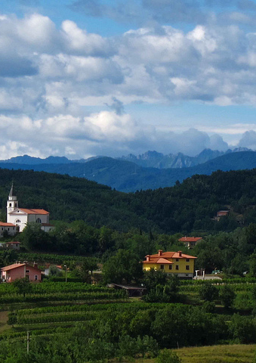
Areas where oranges wines are produced
Kakheti, Georgia
Brda, Slovenia
Friuli-Venezia Giulia, Italy
Sicily, Italy
Swartland Region Western Cape, South Africa
Long Island, NY, USA
Adelaide and Victoria, Australia
Strohmeier, Austria
Sierra Foothills and Napa Valley, CA, USA
Finger Lakes Region, NY, USA
Spain, Greece, Argentina, Chile, Oregon, Czech Republic, France, Croatia
Other areas are beginning to experiment with Orange Wine making (ie; Maryland and Illinois)
This Photo by Unknown Author is licensed under CC BY

Slide 5
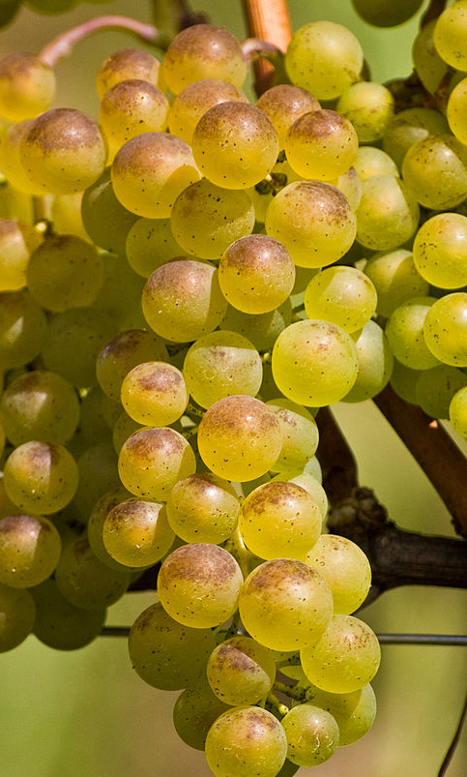
Grape varieties used
Sauvignon Vert
Semilon
Chardonnay
Sauvignon Blanc
Pinot Grigio
Ribolla Gialla
Rkatsiteli
Ritovska
Malavasia Bianca
Chenin Blanc
Local Varieties:
Királeányka
Macabeu
Fiano
Debina
Catarratto
Mtsvane
And so much more…
Any white wine grape could be used to make orange wine!
This Photo by Unknown Author is licensed under CC BY-SA

Slide 6

FLAVORS & AROMAS
Hazelnut
Honey
Butterscotch
Sourdough
Orange rind
Almonds
Autumnal fruit
Mushrooms
Apricot
Apple
Church spice
Lemon peel
Sour beers
Baking spice
Chicken stock
Earthy flavors and aromas
Black tea
Chamomile
This Photo by Unknown Author is licensed under CC BY-NC-ND

Slide 7
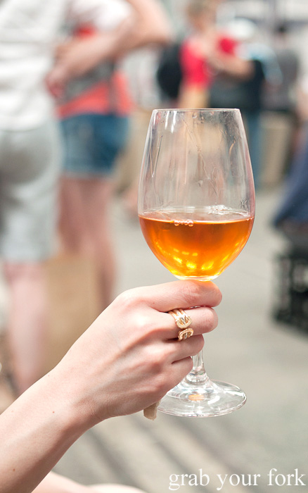
Food pairing guidelines
Orange wine may stand in as a red wine for your dinner since it has more tannins and body than a white wine.
Pairs well with charcuterie, strong cheese, & olives
Autumnal foods:
  Squash, mushrooms, roasted dishes
Assorted vegetables
Indian cuisine
  Curries, heavily spiced dishes
Eastern European foods; pickled foods
Moroccan food
Ethiopian foods
AVOID DELICATE, LIGHT FOODS
This Photo by Unknown Author is licensed under CC BY-NC-ND

Slide 8
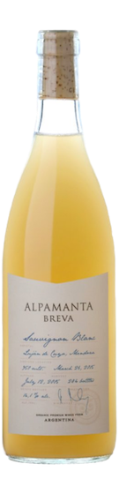
Alpamenta Breva, 2017
Origin: Mendoza, Argentina
Grape Variety: Sauvignon Blanc
4 months in barrel with indigenous yeasts no temperature control
  Unfiltered, Sediment present
Alpamanta means "Love to Earth" or "terrior."
Tasting Notes: rich-textured and zesty, aromas of peach, lemon, white flower, and dulce de leche.
ABV: 14%

Slide 9
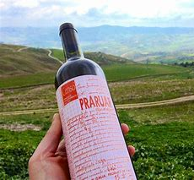
Il Censo 2015 “Praruar” Terre Siciliane Bianco
“Praruar” means “towards gold” in the old Sicilian
Grape variety: 100% Catarratto
  20 days with skin contact
One year in stainless steel with no thermoregulation
  sulfur added only near the time of bottling.
Tasting notes: Fresh-baked gingerbread, citrus honey, quince paste, and Church spices (myrrh, frankincense), notes of chamomile and preserved lemon.
ABV: 13.5%

Slide 10
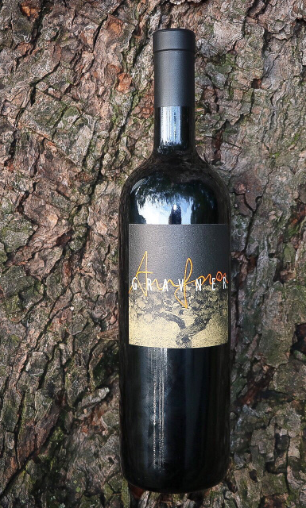
Gravner, ‘Breg Anfora’ 2005
Region: Friuli-Venezia Giulia, Italy
Varieties: Sauvignon Blanc, Riesling Italico, Chardonnay blend
Grapes sit on the skins in amphora for around twelve months;
  aged in casks for about six years before bottling, without fining or filtration.
Tasting notes: Candied orange peel, honey, savory, nutmeg, candied apricot, butterscotch, caramel and almond paste. Great elements of minerality and earthiness.
ABV: 14.5%
The founding wine maker, Josko Graver, is also known as the father of modern orange wine making.

